Slide 1





REST APIs for game match

Slide 2
Contents
Architecture
REST APIs Design
Datamodel Design
Unit testing

Slide 3
Main features include:
User and interest information management
Game auto-matching based on user geography and user interest game and level
Search maximum credits based on user interest game and level

Slide 4
High Level Architecture
Common
REST API
Controller layer
Spring Data JPA
Data Access layer
HTTP
Service
Java
Client
JSON
H2 Database

Slide 5
System:
Package overview:

Slide 6
REST APIs Design
User Entity
No. | API method | HTTP method | URI Path | Status Code | Description
1 | getAllUsers | GET | /api/user | 200 (OK) | Get all users
2 | getUserById | GET | /api/user/{userId} | 200 (OK) | Get user by userId
3 | createUser | POST | /api/user | 201 (CREATED) | Create user
4 | updateUserById | PUT | /api/user/{userId} | 200 (OK) | Update user by userId
5 | deleteUserById | DELETE | /api/user/{userId} | 200 (OK) | Delete user by userId
6 | getMatchUserByGame AndLevelAndGeography | GET | /api/user/match?game=#&level=#&geography=# | 200 (OK) | Get a list of matched users with same game, level and geography
7 | getOtherUserMatchUserInterest | GET | /api/user/{userId}/match/ {interestId} | 200 (OK) | Get a list of other users that matches user geography and user interest game and level
8 | getUserWithMaxCredit ByGameAndLevel | GET | /api/user/interest/credit/max?game=#&level=# | 200 (OK) | Get a list of users with maximum credit among users with same game and level

Slide 7
REST APIs Design
Interest Entity
No. | API method | HTTP method | URI Path | Status Code | Description
9 | getInterestByInterestId | GET | /api/user/{userId}/interest/ {interestId} | 200 (OK) | Get interest by interestId
10 | createInterestByInterestId | POST | /api/user/{userId}/interest | 201 (CREATED) | Create interest
11 | updateInterestByInterestId | PUT | /api/user/{userId}/interest/ {interestId} | 200 (OK) | Update interest by interestId
12 | updateUserInterestCreditByInterestId | PUT | /api/user/{userIid}/interest/ {interestId}/credit?credit=# | 200 (OK) | Update user interest credit
13 | deleteUserInterestByInterestId | DELETE | /api/user/{userId}/interest/ {interestId} | 200 (OK) | Delete interest by interestId

Slide 8
Swagger 3.0
API docs

Slide 9
Request body
Query parameter

Slide 10
Datamodel Design
One-to-many

Slide 11
Common: validator
Entity | Attribute | Validator | Comments
User | name | @NotBlank @Size(min = 2, max = 45) @Pattern(regexp = "^[A-Za-z0-9]+$”)
 | gender | @NotBlank, @InStringArray | Gender should be 'male' or 'female'
 | nickname | @NotBlank @Size(min = 2, max = 45) @Pattern(regexp = "^[A-Za-z0-9]+$”)
 | geography | @NotBlank, @InStringArray | Geography should be one of 'Europe', 'Asia', 'USA'
Interest | game | @NotBlank, @InStringArray | Game should be one of 'fortnite', 'call of duty', 'dota', 'valhalla', 'among us'
 | level | @NotBlank, @InStringArray | Level should be one of 'noob', 'pro', 'invincible'
 | credit | @PositiveOrZero

Slide 12
Common: custom-validator
@InStringArray

Slide 14
Common: exception
ResourceNotFoundException (404 Not Found)
InvalidRequestException (400 Bad Request)
MethodArgumentNotValidException (400 Bad Request)

Slide 15
Unit testing

Slide 16
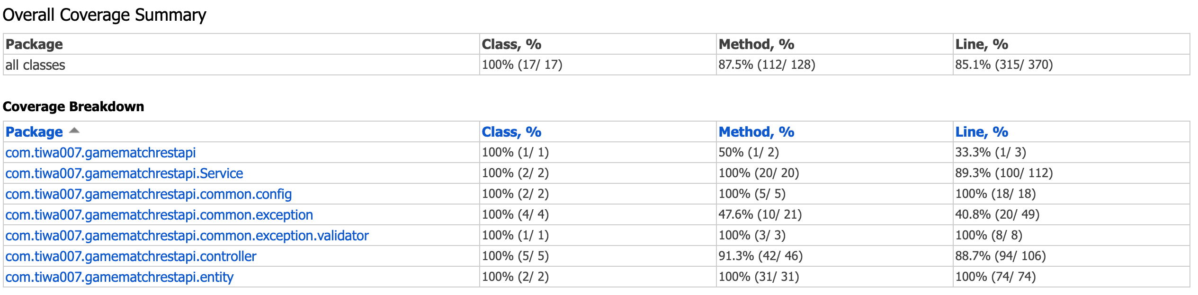
Unit testing coverage

Slide 17

Thank you for your attention!

